Slide 1
A340 Lecture 18
Object-oriented Programming

Slide 2
A basic counter class
class Counter {
var $step;
var $count;
function ChangeStep($newval)
{ if(is_integer($newval))
$this->step = $newval;
}
function Counter()
{ $this->Reset(); )
function Step()
{ $this->count += $this->step; }
function Reset()
{ $this->count = 0; $this->step = 1; }
}

Slide 3
Creating a class library
Start with the state table
Identify the key views and forms and pseudo actions (control steps that refer to other displayed methods)
These become the target actions of the class
Identify the supporting functions
Identify the data entities that these functions will need to have access to
These become the attributes of the class
Develop the constructor and data loading methods
Add attribute query methods to facilitate testing

Slide 4
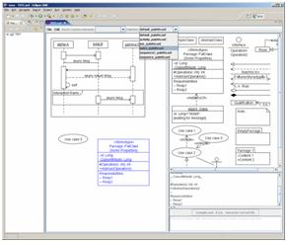
UMLet
http://www.umlet.com/
Java applet template
Convenient editing

Slide 5
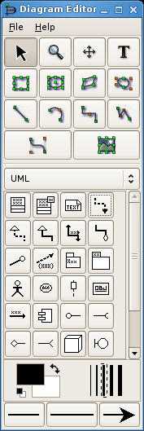
DIA
Homepage: http://live.gnome.org/Dia
Requires GTK that is compatable with OS
Excellent for ERD and State diagrams

Slide 6
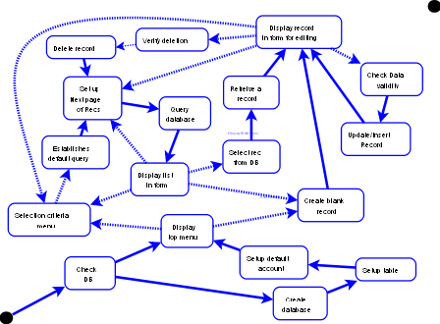
State Diagram

Slide 7
Views (Forms and Displays)
Forms
List of Records
Edit/Display Record
Select search criteria
Top Menu
VerifyDeletion
Control steps
Validate input
Add record

Slide 8
Attributes:
Constants/attributes set at initialization:
Database name (string)
Table name (String)
Field names in the database (Arrray of String)
Field labels in forms (Associative array)
Field labels in tables (Associative array)
Default selection criteria (String)
General attributes
Field values for a record (Associative array)
Search range number (Integer)
Data validation strings (Associative array of regular expressions)

Slide 9
Framework Comparison Chart
Framework | PHP 4 | PHP 5 | M V C¹ | Multi DB's² | O R M³ | DB Objs⁴ | Tem-plates⁵ | Cach-ing⁶ | Vali-dation⁷ | Ajax⁸ | Auth Mod⁹ | RSS PDF¹⁰
Zend Framework | - | X | X | X | - | X | - | X | X | - | - | X
CakePHP | X | X | X | X | X | X | - | X | X | X | X | -
Symfony Project | - | X | X | X | X | X | - | X | X | X | X | -
Seagull Framework | X | X | X | X | X | X | X | X | X | - | X | X
WACT | X | X | X | X | - | X | X | - | X | - | - | -
Prado | - | X | - | X | - | - | X |  | X | X | X | X
PHP on TRAX | - | X | X | X | X | X | - | - | X | X | - | -
ZooP Framework | X | X | X | X | - | X | X | X | X | X | X | X
eZ Components | - | X | - | X | - | X | X | X | X | - | - | X
CodeIgniter | X | X | X | X | - | X | X | X | X | - | - | X

Slide 10
Project
Background:
Unemployment in the area is at a record high.
Older workers tend to submit hundreds of application to get a job.
Description of the service:
a tool to facilitate deep search job hunting.
Maintains upto 6 versions of resume and 12 references.
Monitor job applications deadlines.
Monitor test, phone call and interview schedules.
Store a record of what was sent where.
Maintain log of communications and pdf archive of submitted material.
Schedule things requiring follow up.
Keep information confidential.

